Slide 1

Model & Shape your
Data in a day with Power BI
<instructor>
February 2020 Version
Based on previous Data Modeling & Data Shaping courses by

Slide 2
Prerequisites and Setup Steps
Internet connectivity: You must be connected to the internet
At minimum, a computer with 2-cores and 4GB RAM running Windows 8 / Windows Server 2008 R2 or later
Microsoft Power BI Desktop requires Internet Explorer 10 or greater
Verify if you have 32bit or 64bit operating system to decide if you need to install the 32bit or 64bit applications.
Search for computer on your PC, right click properties for your computer
You will be able to identify if your operating system is 64 or 32 bit based on “system type” as shown below
Download and install Power BI Desktop: Download and install Microsoft Power BI Desktop from http://www.microsoft.com/en-us/download/details.aspx?id=45331. Optionally, you can also install the Power BI Desktop tool from the Power BI Desktop Install folder on the flash drive that will be provided on the day of the session. Please choose appropriate 64-bit or 32-bit version depending on your platform. Microsoft Power BI Desktop is available for 32-bit (x86) and 64-bit (x64) platforms
Download Class Files:
Copy Files from your USB to C:\Power BI_Adv_M\ (Please return the USBs) or download from:
https://partner.microsoft.com/en-US/asset/collection/advanced-shaping-student-collection#/
DIAD: This class assuming that the attendees have already taken Dashboard in a Day and have previous 100 level knowledge of Power BI
NOTE: This lab is using real anonymized data and is provided by ObviEnce LLC. Visit their site to learn about their services: www.obvience.com.
This data is property of ObviEnce LLC and has been shared for the purpose of demonstrating PowerBI functionality with industry sample data. Any uses of this data must include this attribution to ObviEnce LLC.
Notes:
Update Title Slide:
Instructor Name, Title & Company
Instruct the students to copy the files (note, as the Module 4 Lab: Creating Parameters and Paths has them creating a dynamic path, they actually can put the files wherever they want to).

Slide 3

Event Evaluation
Your feedback is important to us!
From your PC, Tablet or Phone, visit
http://aka.ms/AnalyticsAirliftSurvey
https://aka.ms/AnalyticsAirliftPBI
to fill out event evaluations.
Notes:
http://www.surveygizmo.com/s3/3625920/DIS-Partner-Pre-Day

Slide 4
Get Involved on Social
Join the Power BI Community
Event Hashtag: #AnalyticsAirlift
https://community.powerbi.com/
Follow us on:
Twitter: @MSPowerBI
Facebook: Microsoft Power BI

Slide 5
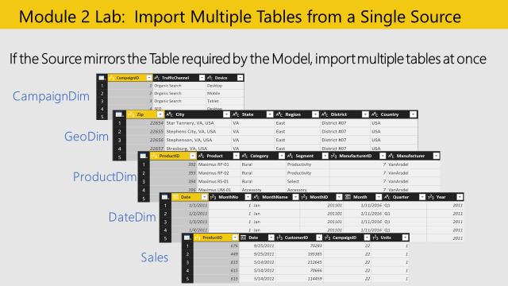
Module 1 Lab 1 – 10 min
Get Data from Excel
Transform data option
Module 1 Lab: Import Multiple Tables from a data Source
Students Notes
Step by Step
VERSION CHECK!!
Objective: Import multiple worksheets from an Excel file in one step
Get Data > from Excel
C:\Power BI_Adv_M\VansArsdel_Actuals.xlsx
Select the following Tables (All but CustomerDim):
CampaignDim
GeoDim
ProductDim
DateDim
Sales
Before uploading select Transform Data
In GeoDim, change the [ZIP] Data Type to Text

Slide 6
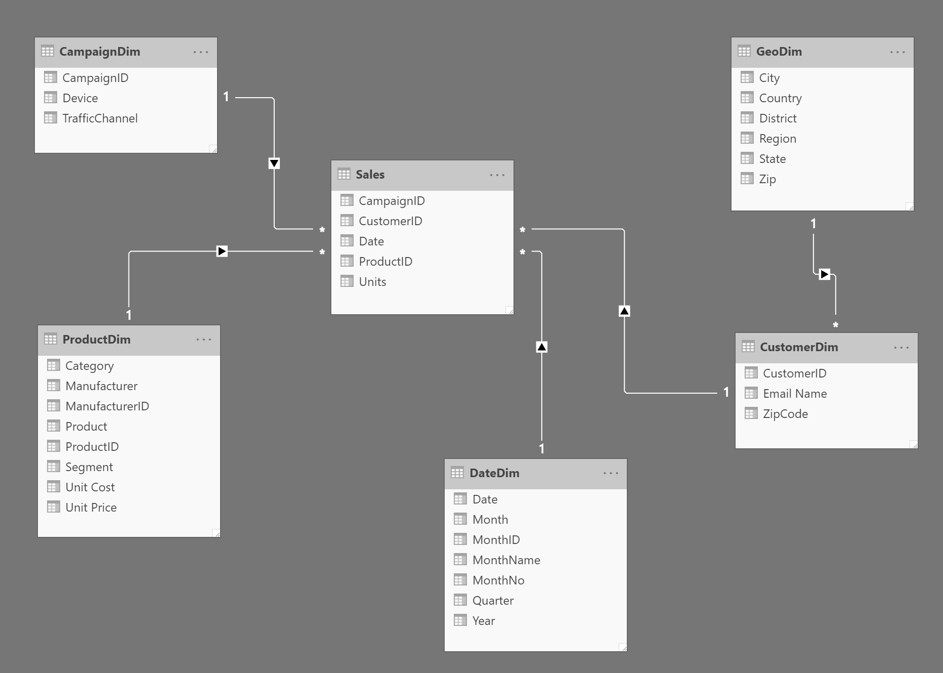
Module 2 Lab 1 – 20 min
Create relationship between the tables
According to business needs
Discuss together in class:
Which relationships were already detected by Power BI?
Which table is the Fact Table?
Which are the dimensions tables?
Which type and direction are you going to choose?
Which schema have you created
Step by Step
Navigate to Model view
Drag a relationship line between CampaignID field from CampaignDim table and CampaignID field from Sales table
Similarly, create relationship between
CustomerID fields in CustomerDim and Sales table
ProductID fields in ProductDim and Sales table
Date fields in DateDim and Sales table
Drag a relationship line between Zip field from GeoDim table and ZipCode from CustomerDim table
Students Notes

Slide 7
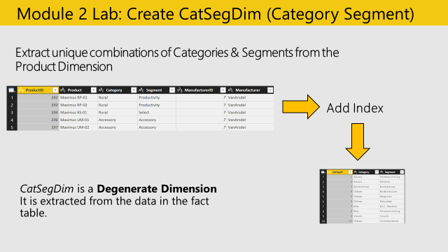
Module 2 Lab 2
Create New Dimension Table - Product Category Dimension
Module 2 Lab 2: Create CatSegDim (Category Segment)
Students Notes
Step by Step
Objective: Create the Product Category Dimension by extracting Categories from the ProductDim
Duplicate the ProductDim query
Highlight [Category] and [Segment], and Remove other columns
Highlight [Category] and [Segment], and Remove Duplicates
Add Column > Add Index Column starting at 1, with column name [CatSegID]
Reorder Columns: [CatSegID], [Category], [Segment]
Rename the query “CatSegDim

Slide 8
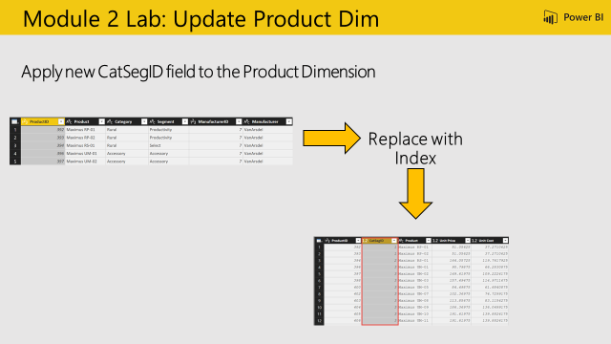
Module 2 Lab 3: Update Product Dim
Module 2 Lab 3
Update Product Dimension Table
Objective: Update the Product Category ID in the ProductDim
Students Notes
Step by Step
Select the ProductDim query
From Home Ribbon > Merge Queries > Select ProductDim
From ProductDim, highlight [Category] and [Segment]
From CatSegDim, highlight [Category] and [Segment]
Note the Join Kinds available, and leave Left Outer
BETTER explain Step – the menu changed in the left outer join function
Expand the [NewColumn] > Select [CatSegID] and deselect “Use Original column name as prefix”
Remove columns: [Category], [Segment], [Manufacturer ID],and [Manufacturer].
Hint: There is only one manufacturer name and one manufacturer ID, so we don’t need this information!
Reorder columns: [ProductID], [CatSegID], [Product], [Unit Price], [Unit Cost]

Slide 9
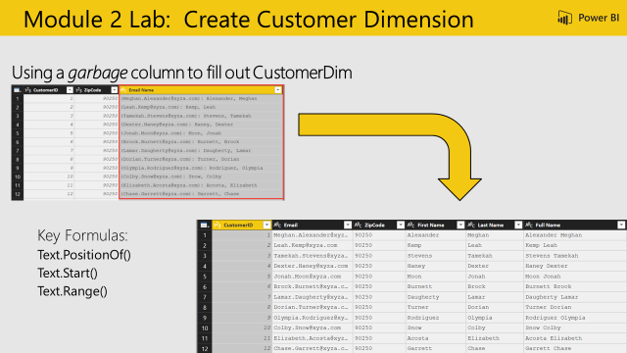
Module 2 Lab 4
Create Customer Dimension Table
Objective: Create a First, Last, and Full Name
columns based on the Email Name column.
Module 2 Lab 4: Create Customer Dimension
Students Notes
Step by Step
Use Recent Sources to get CustomerDim from Excel
Change the ZipCode column data type to TEXT
Split by Delimiter Custom “: “ colon space
Replace to Remove ( @ )
Add Column to find Text.PositionOf() the comma
Add Column > Custom Column
Name = “Separator”
Formula = Text.PositionOf([Email Name.2],",")
Use position of comma to split Last Name and First Name Add Columns for First Name, Last Name and Full Name Last Name = Text.Start([Email Name.2],[Separator]) First Name = Text.Range([Email Name.2],[Separator]+2) Full Name = [First Name] & " " & [Last Name]

Slide 10
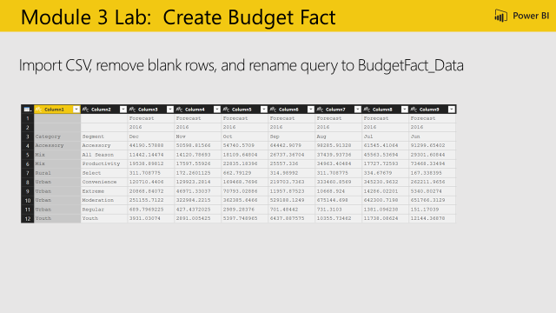
Module 3 Lab 1: Create Budget Fact
Module 3 Lab 1 Fact Table
Create Budget Fact
Objective: Create the Budget Fact
Students Notes
Step by Step
Import CSV document “C:\Power BI_Adv_M\VanArsdel_Budget.csv”
Duplicate the query we will use this information later
Rename the first query from VanArsdel_Budget to BudgetFact_Data
Remove Rows > Remove Top Rows, enter 3 (to remove the first 3 rows)

Slide 11
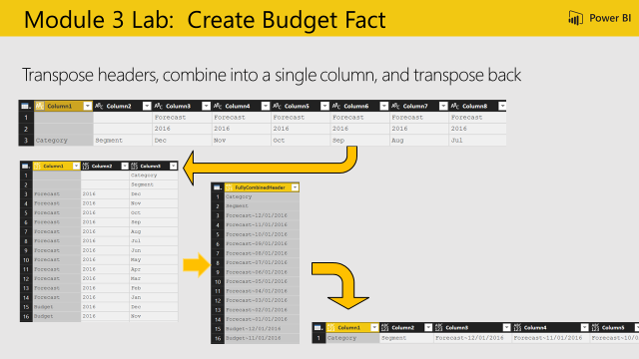
Module 3 Lab 2: Create Budget Fact
Module 3 Lab 2
Create Budget Fact part 2
Objective: To Create a Header which combines the first three rows
Students Notes
Step by Step
Transform > Transpose
Add Column > Custom Column
Add Column to combine month and year into a date
Add Column > Custom Column
Name = “Budget Month”
Formula = try Date.From ([Column3] & [Column2]) otherwise null
Add Column to combine Month and Scenario
Add Column > Custom Column
Name = “FullyCombinedHeader”
Formula = if Text.Length([Column3]) > 3 then [Column3] else [Column1] & "~" & Date.ToText([Budget Month], "M/D/YYYY")
Hint: Day did not come through correctly, as it is case sensitive. Update to “MM/dd/yy”
Remove all columns except for [FullyCombinedHeader]
Transform > Transpose to transpose back to wide

Slide 12
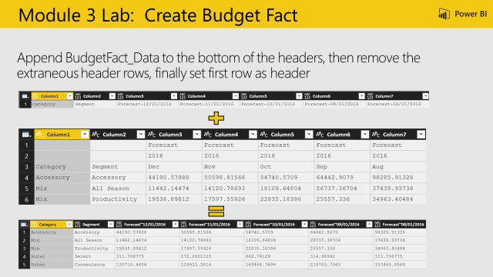
Module 3 Lab 3
Create Budget Fact part 3
Objective: To Append the new header row to the data to create the new wide data table with a single header row
Module 3 Lab 3: Create Budget Fact
Students Notes
Step by Step
Append query BudgetFact_Data
Use First Row as Header to promote the newly fixed header row
Remove Rows > Remove Top Rows, enter 3 (to remove the first 3 rows – the old header rows)

Slide 13
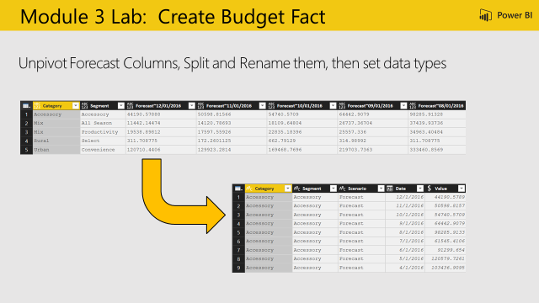
Module 3 Lab 4
Create Budget Fact part 4
Objective: Create the Budget Fact, attribute names and data types
Module 3 Lab 4: Create Budget Fact
Students Notes
Step by Step
Highlight [Category] and [Segment] and Transform > Unpivot Other Columns
Highlight [Attribute] and navigate to Home > Split Column > By Delimiter > “~”
Rename: [Attribute.1] = “Scenario”, [Attribute.2] = “Date”, [Value] = “Budget Amount”
Change the Data Types: [Budget Amount] = Fixed Decimal, [Date] = Date

Slide 14
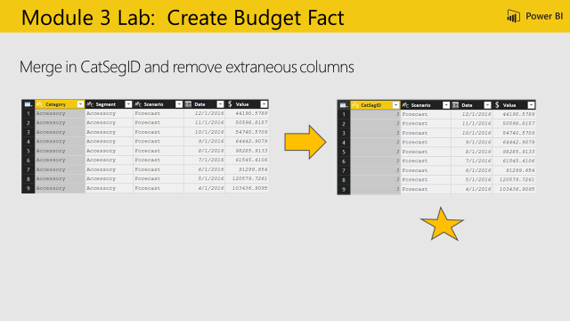
Module 3 Lab 5
Create a Budget Fact
Objective: Merge the queries together to create the final Budget Fact table
Module 3 Lab 5: Create a Budget Fact
Students Notes
Step by Step
Home > Merge Queries > Select CatSegDim
From the CatSegDim highlight both [Category] and [Segment]
Go back up to BudgetFact, highlight both [Category] and [Segment]
Show the Join Kinds available, and leave “Left Outer”
Expand [NewColumn] > Select “CatSegID” and deselect “Use Original column name as prefix”
Remove: [Category], [Segment]
Reorder: [CatSegID], [Scenario], [Date], [Budget Amount]
Disable the load of BudgetFact_Data

Slide 15
Module 4 Lab 1 (30 min)
Working with Measures
Create a measure Total units sold (Hint – it will probably use SUM)
Create a CALCULATED COLUMN on the fact table that shows product category and campaign traffic channel combined
Create visuals to display the Total Units Sold measure
Step by Step
Select Sales Table. From the ribbon select Modeling -> New Measure.
In the formula bar enter:
Total Units Sold = SUM(Sales[Units])
From the ribbon select Format -> Currency -> $ English(United States) to format the measure
Select Sales table. From the ribbon select Modeling -> New Column.
In the formula bar enter:
Category, Campaign = RELATED(CatSegDim[Category]) & ", " & RELATED(CampaignDim[TrafficChannel])
Drag newly created Total Units Sold measure to the canvas. A clustered column chart is created
Drag Units field from Sales table to this visual
Select Device field from CampaignDim table
Add the Device field in both visualizations
Students Notes

Slide 16
Module 4 Lab 2a
Create Parameters
Objective: Update file paths to use dynamic variables
Step by Step
Open the Parameters pane
Define 3 parameters:
Actuals_File
Budget_File
Path
For the Path define the parameters select the following definitions:
Required: checked
Type: Text
Suggested Value = Any Value
For the different parameters use:
Actuals_File = actuals file name VanArsel_Actuals.xslx
Budget _File = budget file name VanArsel_Budget.csv
Path: the path of the current files location: C:\Power BI_Adv_M\
The other parameters will be defined in the next page
Students Notes

Slide 17
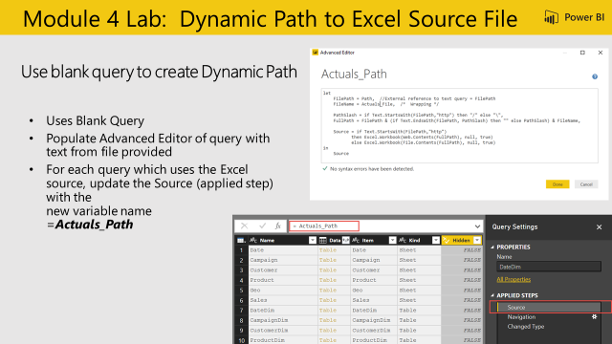
Module 4 Lab 2b
Create Parameters
Objective: Create a query to validate if source is Web or Local and resolve path
Module 4 Lab 2: Dynamic Path to Excel Source File
Step by Step
Create a new blank query
Query Name: “Actuals_Path”
Text as shown in slide (white box) – (Please try to write with the autocomplete before copying )
Update Source Applied Step to use
Resolved Path = “Actuals_Path” to the following Queries:
CampaignDim
CustomerDim
ProductDim
CatSegDim
DateDim
GeoDim
SalesFact
Full Blank Query: Actuals_Path
let
FilePath = Path, //External reference to text query = FilePath
FileName = Actuals_File.xslx, /* Wrapping*/
PathSlash = if Text.StartsWith (FilePath,"http") then "/" else "\",
FullPath = FilePath & (if Text.EndsWith(FilePath, PathSlash) then "" else PathSlash) & FileName,
Source = if Text.StartsWith(FilePath,"http")
then Excel.Workbook(Web.Contents(FullPath), null, true)
else Excel.Workbook(File.Contents(FullPath), null, true)
in
Source
Students Notes

Slide 18
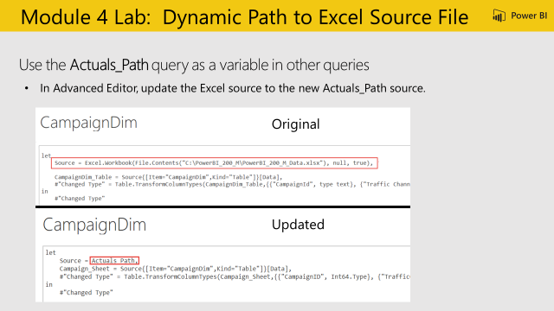
Module 4 Lab 4
Use Variable in dimention table
Objective: Use The Actuals_Path query as a variable to update other queries
Module 4 Lab 4: Replace file path with Parameter
Students Notes
Step by Step
From the table navigation select the CampaignDim query
Find: Source = “” (The location of the Excel source file)
Replace with the parameter previously created:
Source = Actuals_Path,

Slide 19
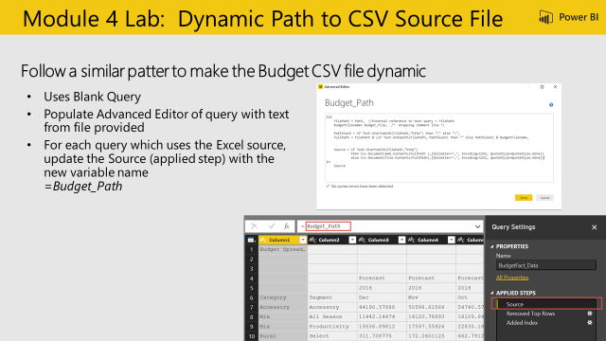
Module 4 Lab 5
Use Variables in Fact Table
Objective: Update CSV file paths to use dynamic variables
Module 4 Lab 5: Dynamic Path to CSV Source file
Students Notes
Step by Step
Create a new blank query
Query Name: “Budget_Path”
Copy in text from Budget_Path.txt
Update Source Applied Step to use ResolvedBudgetPath = “Budget_Path” to the following Queries:
BudgetFact
BudgetFact_Data
https://partner.microsoft.com/en-US/asset/collection/advanced-shaping-student-collection#/

Slide 20
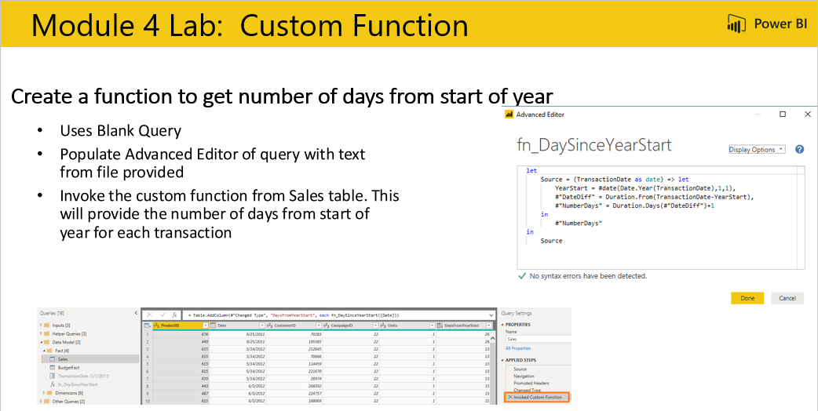
Module 5 Lab 1
Custom Function
Objective: Create a custom function
Module 5 Lab 1: Custom Function
Students Notes
Step by Step
Create a new blank query
Query Name: “fn_DaySinceYearStart”
In Advanced Editor
Copy in text from Number_Days.txt
Create a new Parameter
Parameter Name: TransactionDate
Type: Date
Current Value = 1/1/2011
Update Sales query. Add Column -> Invoke Custom Function
New Column Name: DaysFromYearStart
Function query: fn_DaySinceYearStart
Transaction Date = Date

Slide 21
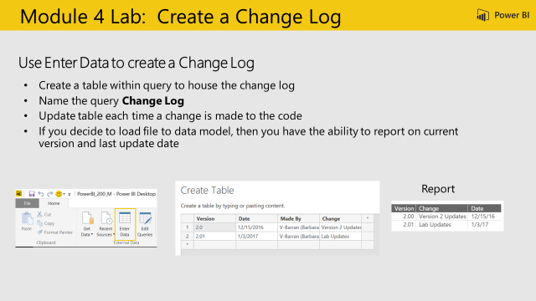
Module 6 Lab 1
Best Practice
Objective: Create a change Log
Module 6 Lab 1: Change Log
Students Notes
Step by Step
From the ribbon use Enter data to create a new table
Name the query that was created: Change Log
Update the table each time a change is made to the code

Slide 22
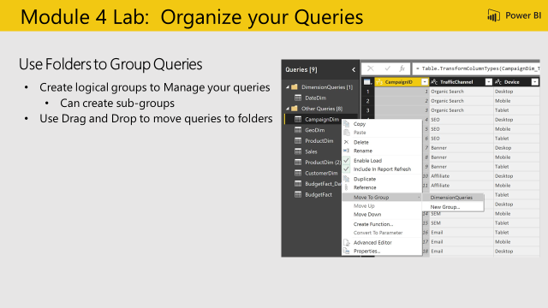
Module 6 Lab 2
Objective: Organize Queries
Module 6 Lab 2: Organize Queries
Students Notes
Step by Step
Organize Queries into folders - Group the queries according to your model
Create Dimensions Queries folder
Move all the dimension tables to this folder using drag and drop
Create Fact folder
Move the fact table into the folder
Create Administrative folder
Move the change log table to the folder
Change queries names for consistency

Slide 23
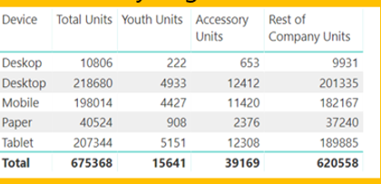
Module 7 – Summary Lab 1
Objective: Create Data Visualization
Create data visualizations for the data you have shaped and modeled.
Include a table visualization showing total units sold in the Youth segment, and all other segments; by Campaign Device
Module 6 Lab 2: Table
Step by Step
Students Notes
Select Sales Table. From the ribbon select Modeling -> New Measure.
Create 3 measures:
Youth Units Sold = CALCULATE([Total Units Sold],FILTER(ProductDim,ProductDim[Segment]="Youth"))
Accessory Units Sold = CALCULATE([Total Units Sold],FILTER(ProductDim,ProductDim[Segment]="Accessory"))
Rest of Company Units Sold = CALCULATE([Total Units Sold],FILTER(ALL(ProductDim),AND(ProductDim[Segment]<>"Accessory",Prod uctDim[Segment]<>"Youth"))
From the ribbon select Format -> Whole Number and Comma to format the measure
Add a table visual and drag CampaignDim -> Device and the 3 newly created measures

Slide 24
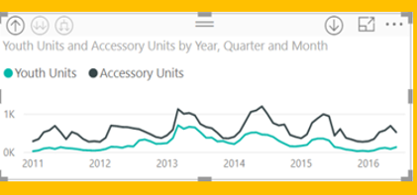
Module 7 – Summary Lab 2
Best Practice
Objective: Create Data Visualization
Include a line chart showing total units sold in Youth and Accessory Segments by month
Module 7 Lab 2: Line Chart
Students Notes
Step by Step
Select Line Chart visual.
Select Date hierarchy from Date table
Select Youth Units Sold and Accessory Units sold measures

Slide 25
Module 7 – Summary Lab 3
Objective: Create Data Visualization
Use the Unit Cost and Unit Price from ProductDim table to calculate Sales Amount, Cost of Goods Sold, Profit and build some visuals around them
Module 7 Lab 3: Your own custom visuals
Students Notes
Step by Step
Create following measures and use a visual to analyze data.
Sales Amount = SUMX(Sales, Sales[Units] * RELATED(ProductDim[Unit Price]))
COGS = SUMX(Sales, Sales[Units] * RELATED(ProductDim[Unit Cost]))
Profit = SUMX(Sales, Sales[Units] * (RELATED(ProductDim[Unit Price]) - RELATED(ProductDim[Unit Cost])))

